Slide 1
The Amateur Satellite Service in the Modern Era

Slide 2

Open Research Institute
https://openresearch.institute

Slide 3
Who is Open Research Institute?
Open Research Institute (ORI) is a non-profit research and development organization which provides all of its work to the general public under the principles of Open Source and Open Access to Research.
501(c) (3) registered in California, USA, with an international multi-disciplinary volunteer team doing advanced amateur radio work for both space and terrestrial applications.

Slide 4
1.
Summary of the Performance of the Amateur Satellite Service
since 1961
4

Slide 5
Timeline
OSCAR 1 launched from Vandenburg Air Force Base. Secondary payload for Corona 9029.
Phase 3B carried a science experiment that was used to determine how accurate the GPS global position service could be used above the satellite orbit.
AO-27, which is a hosted payload onboard EYESAT-1, was an American experimental communications microsatellite with a store-dump payload.
$50SAT was developed by Bob Twiggs at Morehead State University (MSU) along with three other radio amateurs and was used to train students.
The Virginia Tech experimental camera payload on the Fox-1D satellite (AO-92), launched on January 12, returned some very clear photos of our planet as seen from low-Earth orbit.
NEXUS FO-99 is a mission to demonstrate various experimental devices and technology in space.
1961
1974
1983
1990
1993
2000
2013
2015
2018
2018
2019
?
AMSAT-OSCAR 7, launched in 1974, remains semi-operational. It is the oldest amateur satellite still in use, and is one of the oldest operational communications satellites.
Based on the success of UO-11's Digital Communications Experiment, AMSAT-OSCAR-16 was designed to be a dedicated store-and-forward file server in space.
AO-40, The 400 kg, 250 W spacecraft was the largest amateur-support spacecraft, carrying 5 receivers and seven transmitters.
AO-85 is an American amateur radio satellite. It is a 1U Cubesat, was built by AMSAT and carries a single-channel transponder for FM radio.
QO-100, hosted payload on Es'Hail 2, a geostationary satellite.
Our future can be very bright, if we adapt and evolve.

Slide 6
CubeSats, possible due to amateur experimentation and risk-taking, have revolutionized space exploration.
CubeSats have delivered accessibility and affordability.
It’s time for the experimenters and risk-takers to step up again.

Slide 7
The Impact of Government Regulation and the Evolution of Space Services
2.
A. The International Traffic In Arms Regulations
B. Orbital Debris Mitigation Regulations

Slide 8
What have we done about Export Regulations?
Commodity Jurisdiction Request.
Classification Request.
Advisory Opinion Request
Goal: Clearly establish that Open Source satellite work is free of ITAR and EAR. https://github.com/phase4ground/documents/tree/master/Regulatory

Slide 9
Debris Mitigation
An Open Source approach provides a modern and innovative amateur communications service that fully complies with necessary regulations.

Slide 10
An Open Source Roadmap
Open Source design, verification, validation, test, and documentation is all freely available to the general public.
Successfully raise the orbit.
Successfully de-orbit the spacecraft.
1
3
5
2
4
6
Propose innovative and useful launches and missions.
Successfully maintain the orbit.
Document and disseminate all lessons learned.

Slide 11
Adjustments and Adaptations
Changes in Solar Cell Efficiency, RF Device Efficiency, Specialized S/C Technologies (e.g. HELAPS)
Miniaturization of Electronic Devices
The Use of Millimeter Wave Spectrum
The Evolution of the Small Satellite World the Amateur Satellite Community Initiated
Doing More with Less
small propulsion systems and improvements in AOCS.

Slide 12
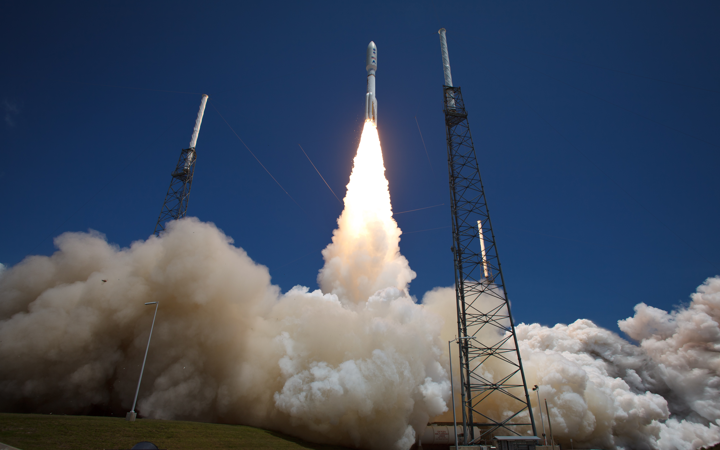
More Adaptations

Slide 13
Orbit Shell Ownership (OSO)
3.
Spectrum Management
Orbital Debris
A Synergy of Regulatory Law
A classical government function that has lead to a vibrant and diverse ecosystem.
An urgent health and welfare problem more closely related to those handled by environmental regulatory frameworks.
Spectrum Management and Pollution Control are related in space, and fall under the authority of the FCC.
1
2
3

Slide 14
How does the Amateur Satellite Service adapt to Orbital Shell Ownership?

Slide 15
ARSS Adaptation to OSO
Maximize Coverage
We must increase orbit altitude in the service in order to provide modern and innovative public communications services.
Minimize Propulsion Requirements
Orbit raising, phasing, and End of Life disposal can both comply with regulations and provide new experimental paths.
Minimize Failure Risk
With proper orbit selection, failed spacecraft and completed missions can be de-orbited quickly.
Use innovative non-commercial orbit strategies.

Slide 16
Why GTO?
GTO is a viable option for Debris Mitigation

Slide 17
GTO satisfies the OSO requirements
Maximum Coverage
Minimize Propulsion
Geostationary Transfer Orbit
Minimize Failure Risk
Minimize Launch Costs

Slide 18
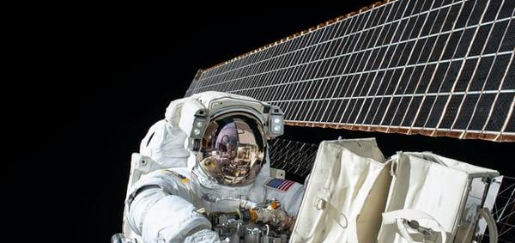
Microwave band spectrum defense is crucial
Minimizes spacecraft Size, Weight, Power
Increases Service Capacity
Minimizes ground equipment size in crowded urban environments

Slide 19
Conclusion
The Amateur Satellite Service (ARSS) Can Provide Citizen-Based Technology Evolution and Support STEM-based Student Learning.
This must be done differently than we have done before.
The Service needs specific FCC Support.

Slide 20
What we assert
Orbital Shells should not be specific to any particular category of service.
High-altitude amateur missions should keep perigee above 1250 km.
A GTO is the best way for amateurs to get in space and provide authentic public communications service.

Slide 21
What we assert
Microwave, digital, broad-band, multi-user, and open source are the MVP requirements for the communications payload.
Amateur missions can comply with Debris Mitigation while providing innovation and opportunity for non-commercial work.
We must have dedicated spectrum to produce innovations on the order of the small satellite revolution.

Slide 22
We embrace the advantages of striving to comply with Debris Mitigation rules. The effort creates more efficient spacecraft, promotes innovation, and minimizes risk of collisions.
Enable ambitious amateur experiment (e.g. Straight to Graveyard)
Defend Amateur Microwave Spectrum

Slide 23
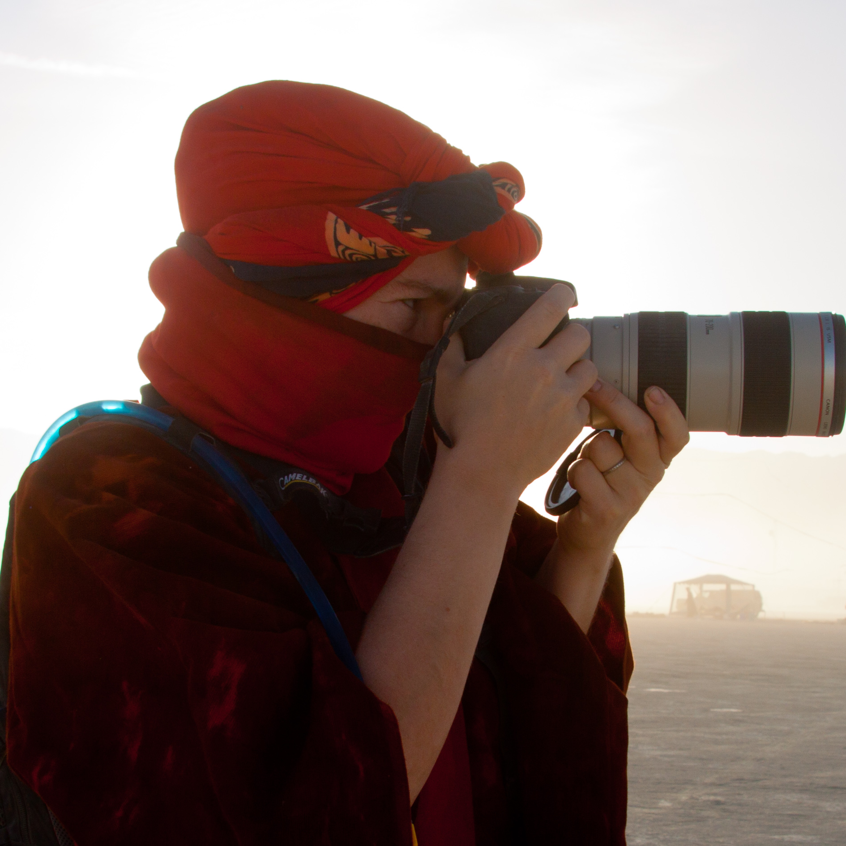
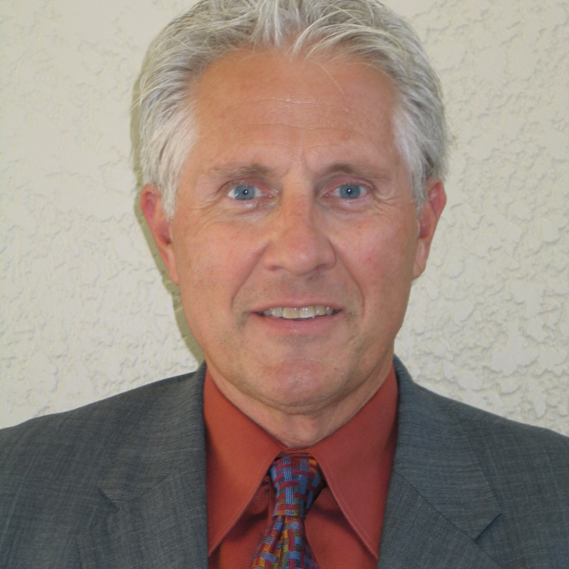
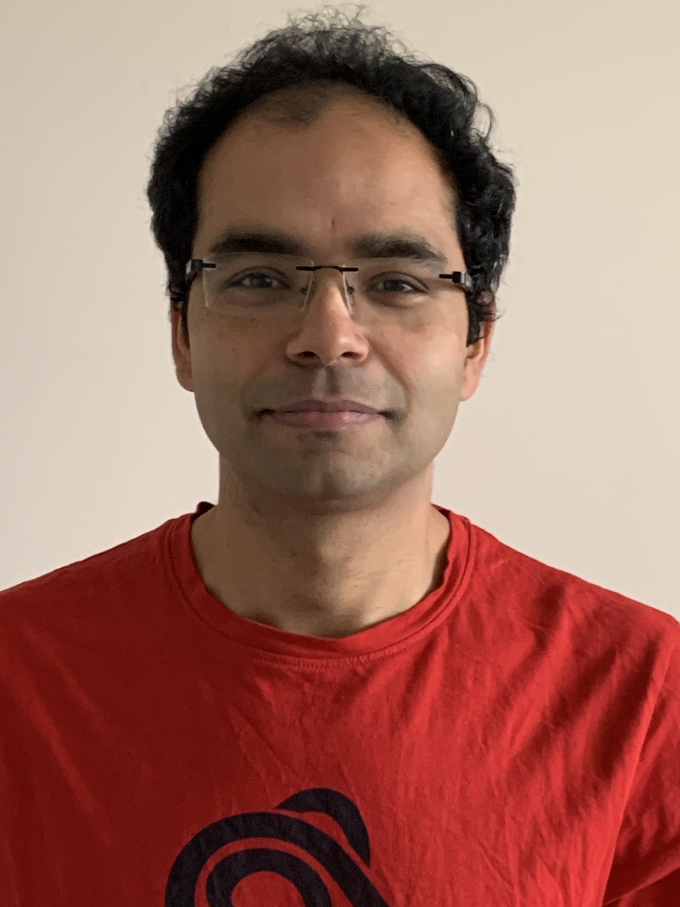
Team Presentation
Michelle Thompson
CEO Open Research Institute
ori@openresearch.institute
Jan King
Founder AMSAT, FCC Part 25 License Holder
jan@astrodigital.com
Anshul Makkar Senior Engineer, Open Research Institute
anshulmakkar@gmail.com
July 2021

